Slide 1
ThorBang MQ
erik jonsson THORén michael BANG
ASL Milestone 1

Slide 2
Agenda
Design of System
Design of Testing Setup
Summary of Experiments
4h trace
Things Learned

Slide 3
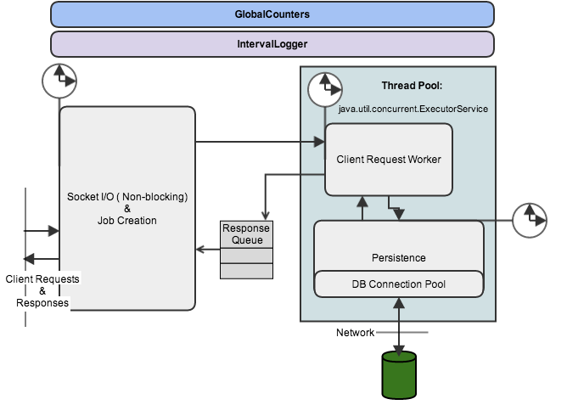

Slide 4
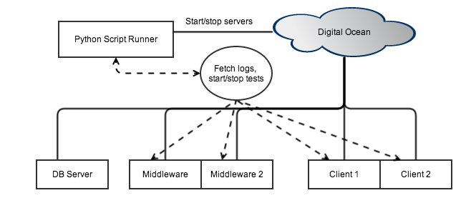
Design of Testing Setup

Slide 5
Design of System
Produced Log Files
Time since server start
Push Requests
Pop / Peek Requests
Total Requests
Total Think Time in Socket I/O and job creation
Total Think Time in Request Worker
Total Think Time in Persistence-component
593135,1101,1090,2191,47713665384,29913823472,29510444900
594136,1200,1214,2414,47829943204,30080084320,29805427278
System.nanoTime() System.nanoTime()

Slide 6
Experiments conducted
Micro-benchmarks
Total number of clients
Number of middleware instances
Number of database connections
Number of worker threads
Frequency of requests
Size of messages
Impact of using database vs. no storage at all
Size of dataset
Client threads per client machine
Number of queues used

Slide 7
Results Of Experiments Conducted
Type of Request | Response Time [ms]
Push Message | 1.86 ± [-0.57 , 0.61]
Peek Queue | 2.02 ± [-0.67 , 0.70]
Pop Queue | 3.99 ± [-0.79 , 1.17]
50 db-connections
50 worker threads

Slide 8
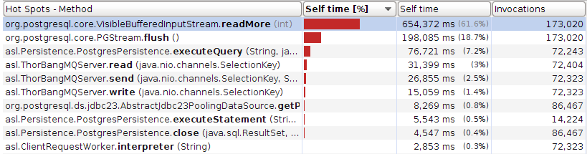
Results Of Experiments Conducted
Top 3 methods make up 87.5% of processing time for middleware

Slide 9
Results Of Experiments Conducted

Slide 10
Results Of Experiments Conducted

Slide 11
Results Of Experiments Conducted
Configuration | Mean Throughput | Response Time [ms]
10 Middlewares | 2476.3 ± 2.2 | 1.15 ± 0.01
1 Middleware | 2406.8 ± 19.1 | 445.51 ± 4.96
From 1 ➔ 10 | +3% increase | 30x decrease
1000 one-way clients (total)
500 two-way clients (total)
30 db connections (per mw)
30 worker threads (per mw)

Slide 12
Results Of Experiments Conducted
Throughput is bounded by the minimum of the two parameters: worker threads and db-connections.
With enough db-connections: performance in bouded by db

Slide 13
4 Hour Trace
50 db-connections
50 worker threads
300 clients
Mean push: 293.91 ± [-28.91 , 21.09]
Mean pop: 1331.73 ± [-53.73 , 42.27]
Mean resp. time: 10.66 ± [-4.54 , 7.06]

Slide 14
Things Learned
Good Parameters
Worker Threads and db-connection 1:1 ratio
Worker Threads: ~40
When throughput hits 1500 consider adding middleware
The database is the bottleneck
Thus increasing middlewares won’t increasethroughput
Maximum Throughput
Standard Test: ~ 2800 req/s
Send And Pop: ~2000 req/s
Bounded by the database

